Slide 1
JIU IT Major 20230124 PMJ, AEJ
Object-Oriented Programming
Practice Week5

Slide 2
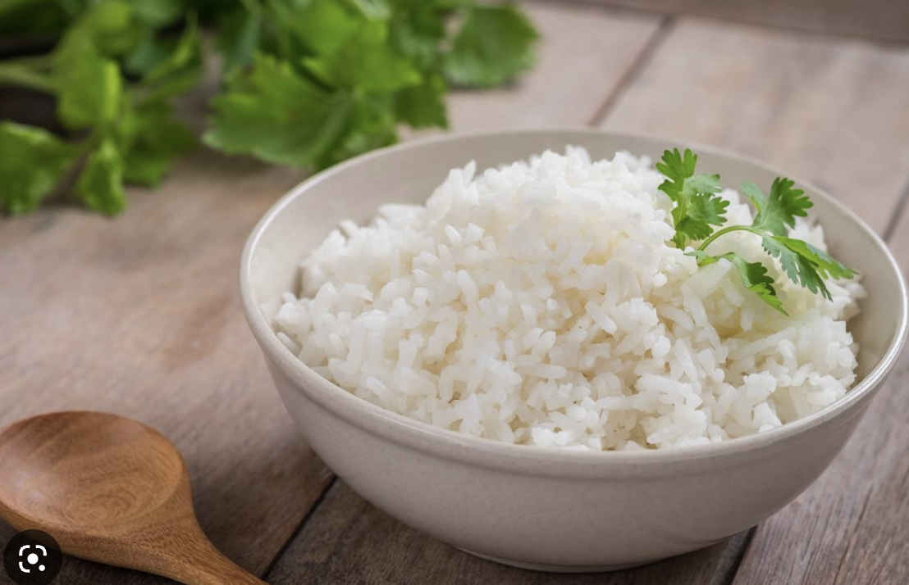
Today we have
NASI + Go
😚 😚 😚

Slide 3
Call by Value?
vs
Call by Reference?

Slide 4
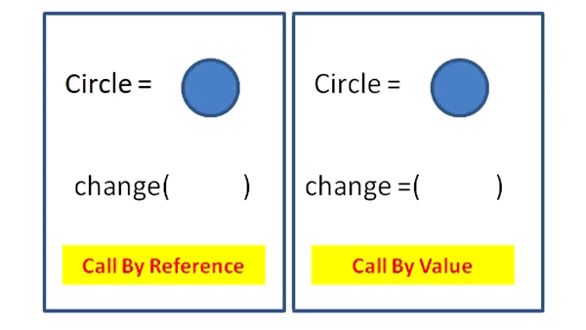

Slide 5
Call By Reference (Pass-By-Reference)
the unique identifier of the object is sent to the method.
Any changes to the parameter’s instance members will
result in that change being made to the original value.

Slide 6
Call By Value (Pass-By-Value)
parameters passed to the callee method will be clones of the original parameters.
Any modification done in callee method will have no effect on the original parameters in caller method.

Slide 7
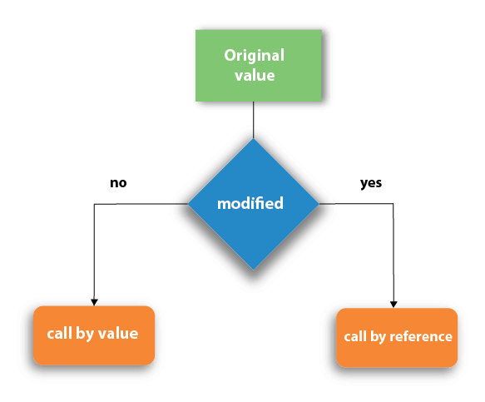

Slide 10
As far as Java is concerned,
everything is strictly Pass-by-Value.

Slide 11
As far as Java is concerned,
everything is strictly Pass-by-Value.

Slide 12
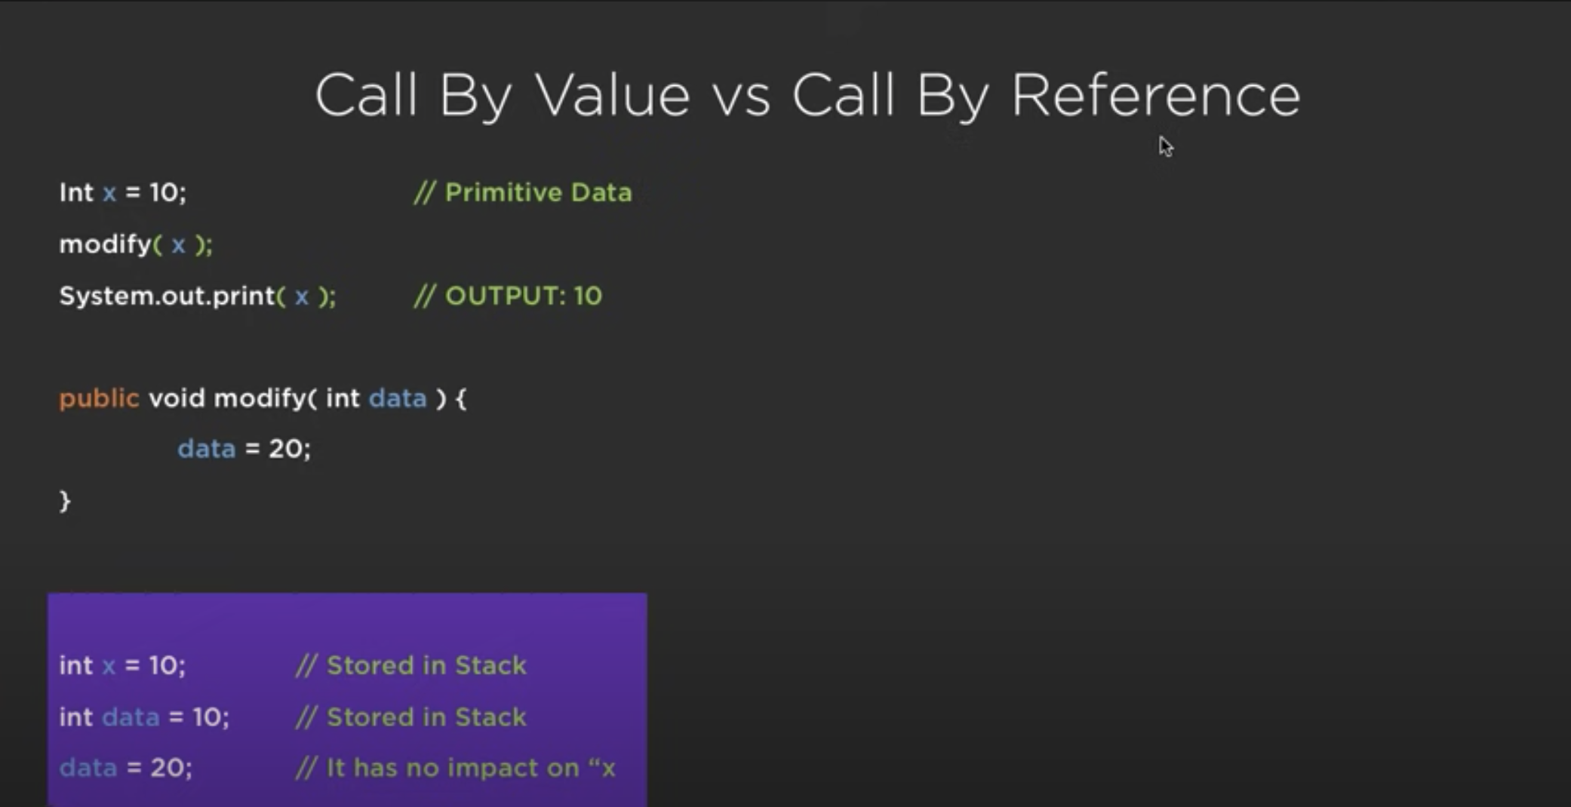
As far as Java is concerned,
everything is strictly Pass-by-Value.

Slide 13
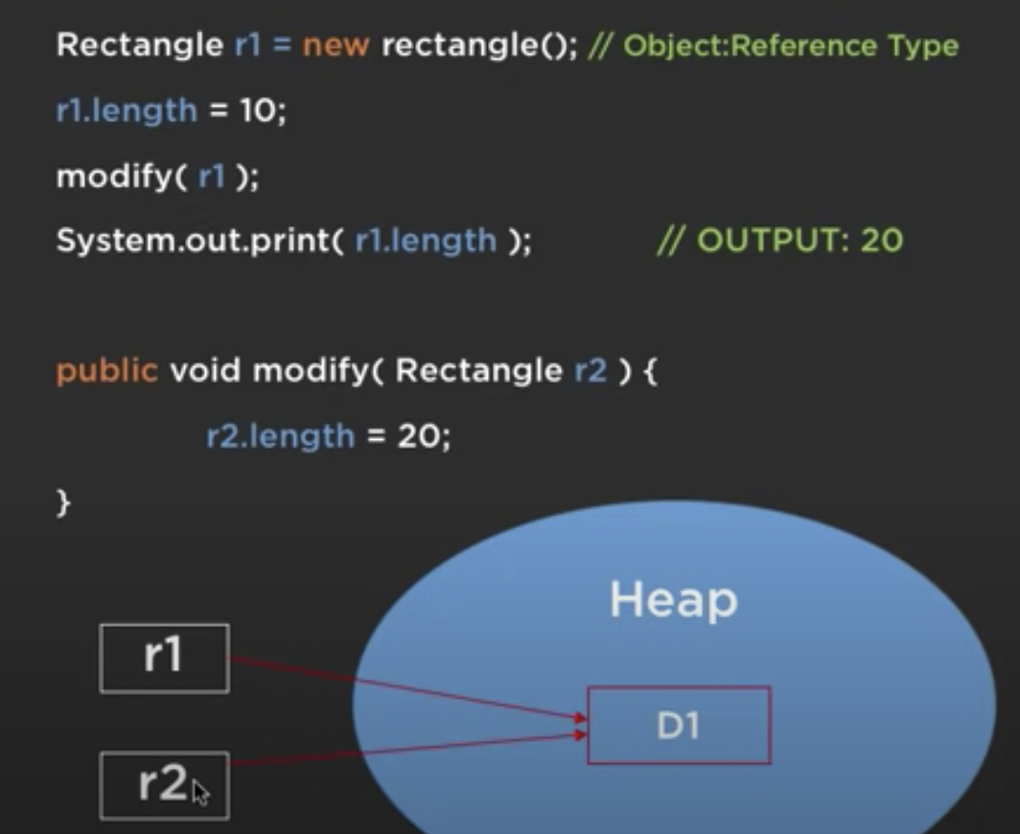
As far as Java is concerned,
everything is strictly Pass-by-Value.

Slide 14
Overloading

Slide 15
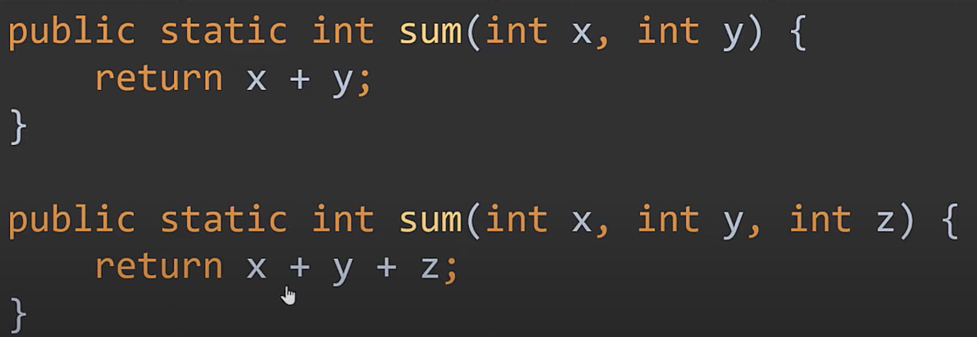
Overloading

Slide 16
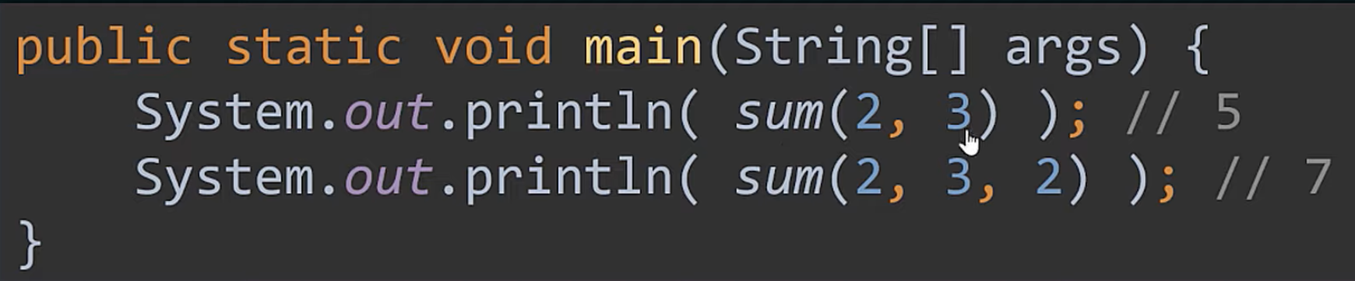
Overloading

Slide 17
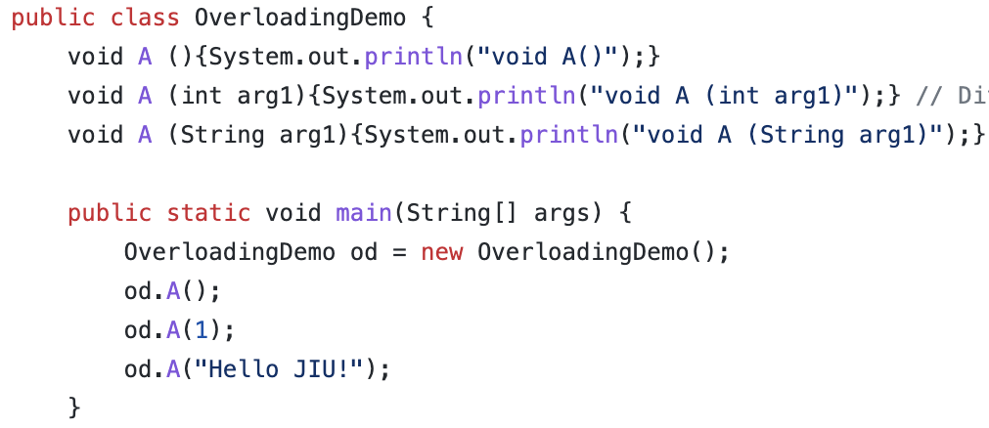
Overloading

Slide 18

Different number of parameter
Overloading

Slide 19
Different number of parameter
Overloading
Same Number of parameters,
but different data types in the parameters

Slide 20
Overloaded Methods
Must have different parameters
Can have different return types

Slide 21
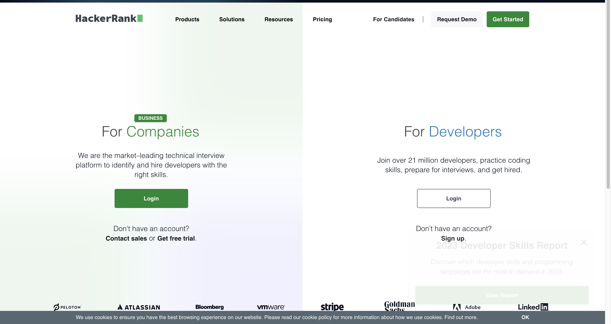
https://www.hackerrank.com/

Slide 22
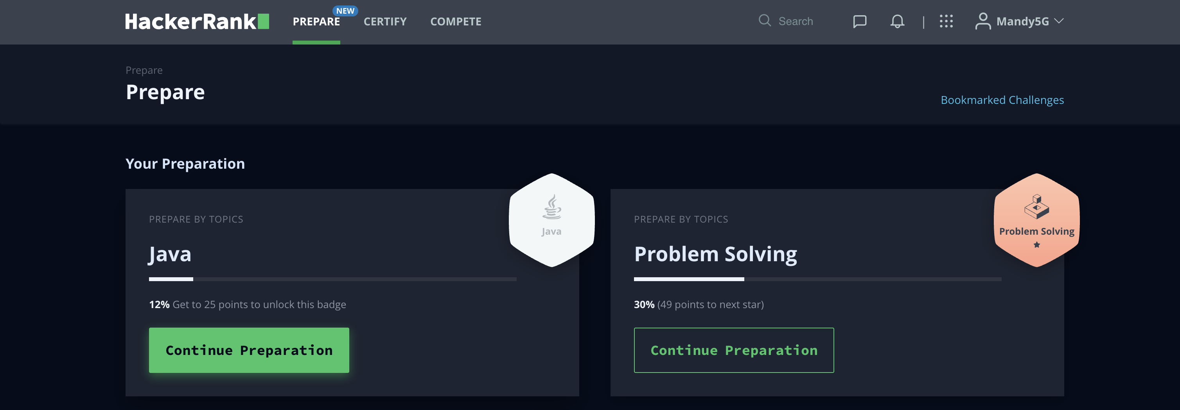
https://www.hackerrank.com/

Slide 23
Introduction to Java
The term Java from Java island….
JIU IT Major 20230124 PMJ, AEJ

